Slide 1
Diachronic corpora
made by A. Naumov
Lmag-101

Slide 2
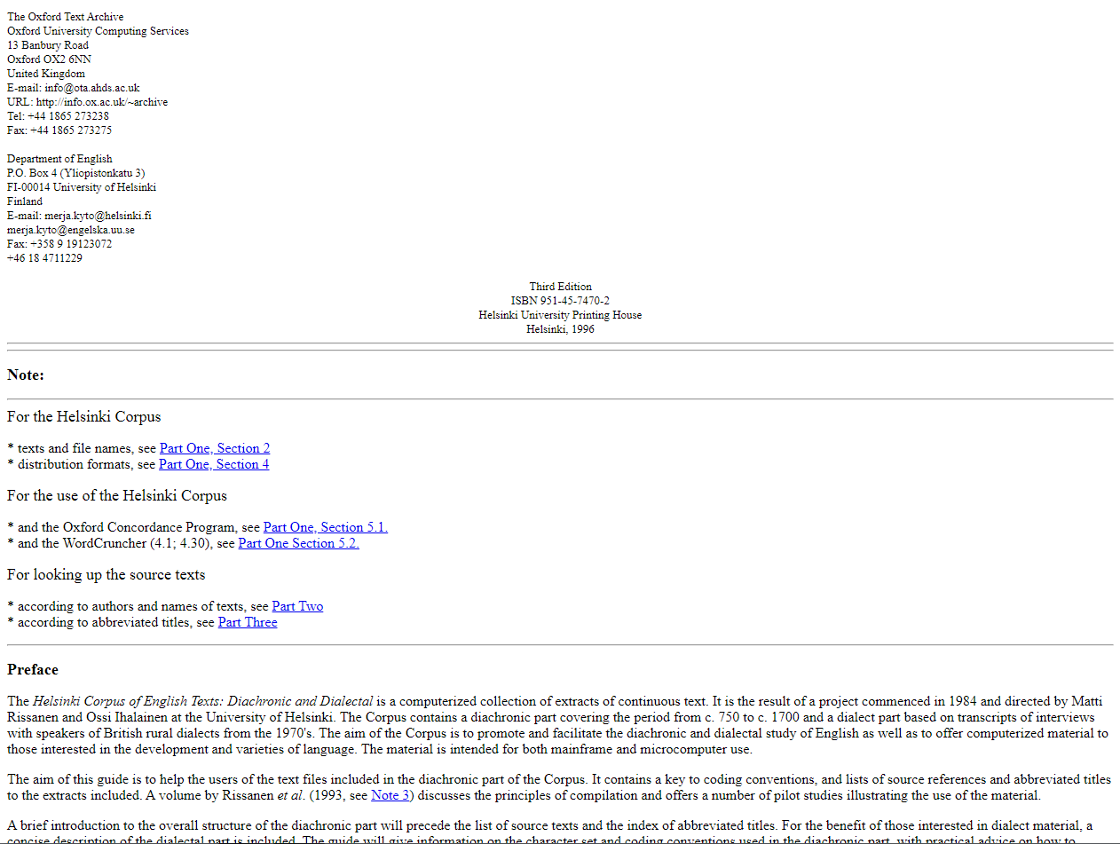
the Helsinki Corpus of English Texts http://icame.uib.no/hc/

Slide 3
Size – 2 742 800
sections: Old English, Middle English, Early Modern English, Scots, Early American English
composition: the corpus covers the period from c. 750 to c. 1700 including various text types, levels of style and modes of expression, geographical and social varieties etc.
related projects: none
access: available in tape, diskette, CD-ROM formats

Slide 4
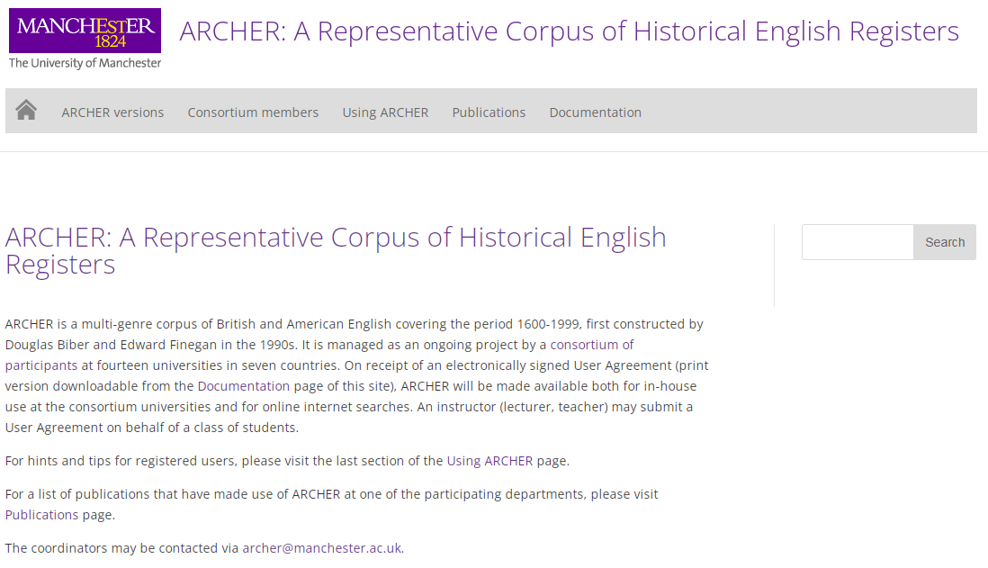
The ARCHER corpus https://www.projects.alc.manchester.ac.uk/archer/

Slide 5
Size – c. 3.3 million words
sections: British English, American English
composition: multi-genre corpus covering the period from 1600 to 1999
related projects: A Corpus of late 18c Prose, A Corpus of late Modern English Prose
access: free (registration needed)

Slide 6
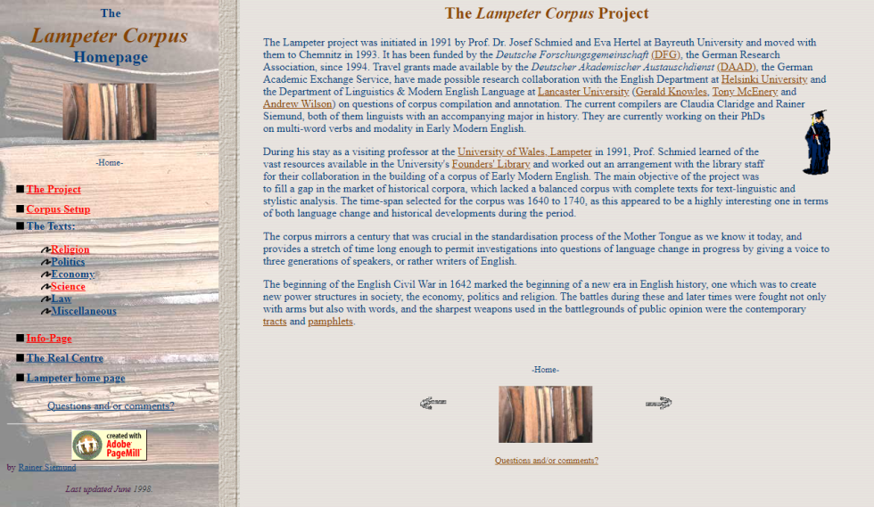
The Lampeter Corpus http://korpus.uib.no/icame/manuals/LAMPETER/LAMPHOME.HTM

Slide 7
Size – 1 193 385 words
sections: Early Modern English
composition: multi-genre pamphlets covering the period from 1640 to 1740, the corpus is subdivided into the six domains RELIGION, POLITICS, ECONOMY, SCIENCE, LAW and MISCELLANEOUS with twenty texts each
related projects: none
access: unavailable

Slide 8
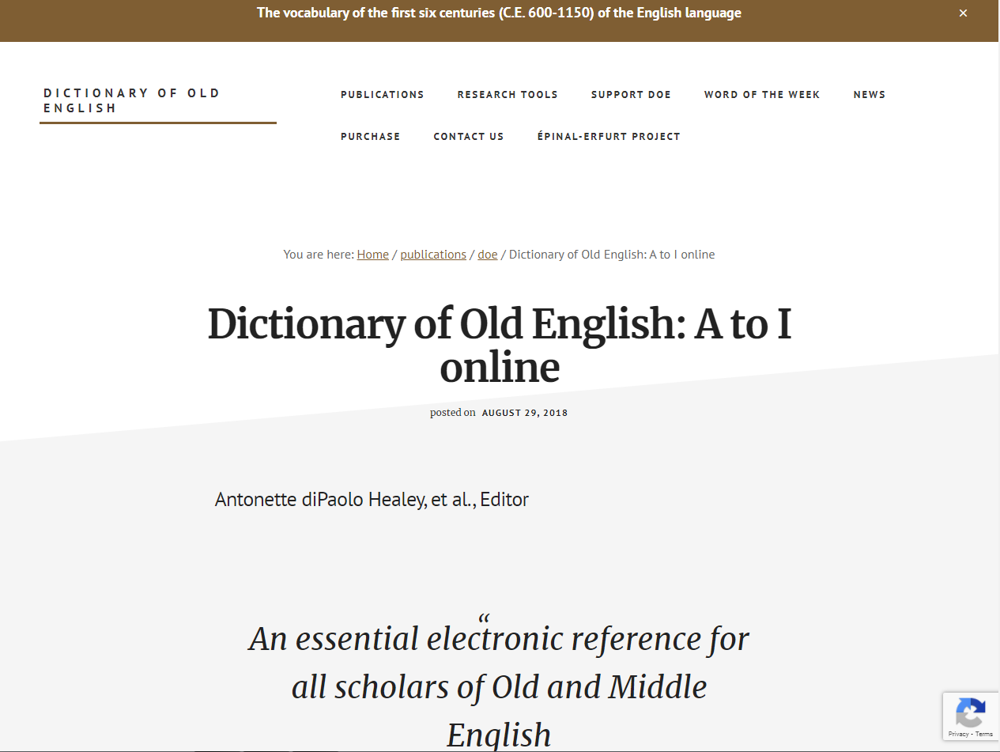
The Dictionary of Old English: A to I online https://doe.artsci.utoronto.ca/?p=87

Slide 9
Size – The DOE: A to I online is based on a computerized Corpus comprising at least one copy of each text surviving in Old English
sections: Old English
composition: multi-genre texts covering the period from 600 to 1150
related projects: Middle English Dictionary, Oxford English Dictionary
access: Site License for the Web Corpus: institutions- $200.00, individuals- $75.00. The Corpus on CD-ROM: initial purchase: $200.00

Slide 10
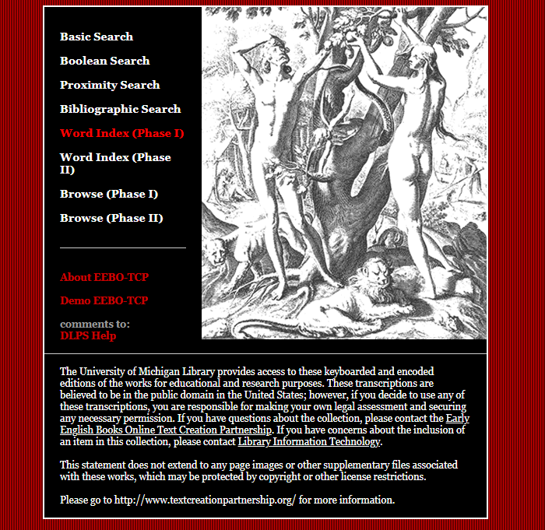
Early English Books Online https://quod.lib.umich.edu/e/eebogroup

Slide 11
Size – more than 125,000 volumes
sections: Early English
composition: multi-genre texts covering the period from 1475 to 1700
related projects: Text Creation Partnership, ProQuest, Early English Books Online Database
access: free

Slide 12
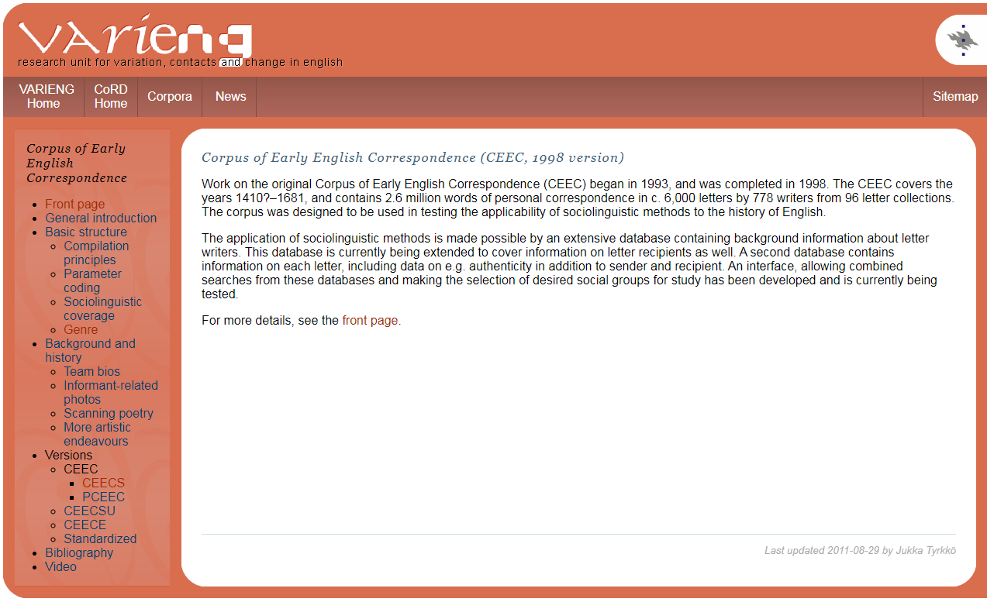
Corpus of Early English Correspondence https://varieng.helsinki.fi/CoRD/corpora/CEEC/ceec.html

Slide 13
Size – 2,597,795 words
sections: English (Late Middle, Early Modern, Late Modern)
composition: correspondence texts covering the period from 1410 to 1681
related projects: Parsed Corpus of Early English Correspondence, Standardized-spelling Corpora of Early English Correspondence
access: available in ICAME CD-ROM format and in the Oxford Text Archive

Slide 14
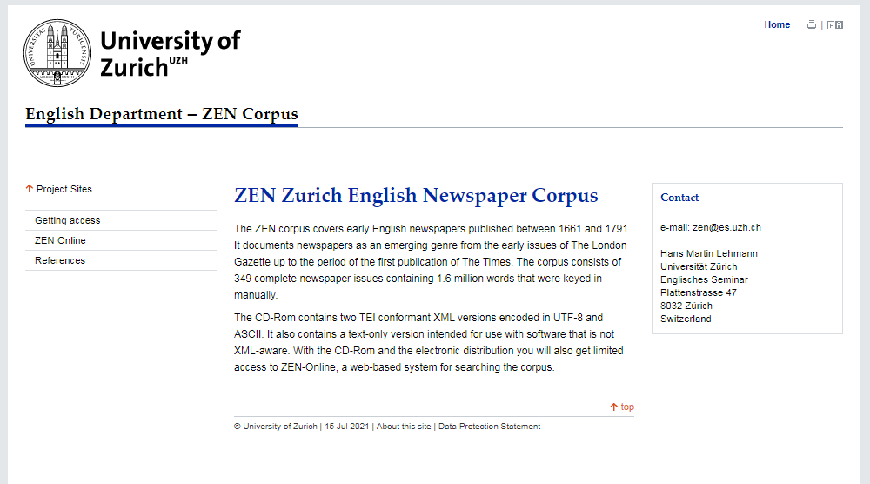
Zurich English Newspaper Corpus https://www.es.uzh.ch/en/Subsites/Projects/zencorpus.html

Slide 15
Size – about 1 600 000 words
sections: newspapers
composition: newspapers covering the period from 1661 to 1791
related projects: SPARCLING, Zurich in Anglophone Literatures, The Liberian Literature Project, UZH Alumni English Studies
access: available in CD-ROM format and free online (registration needed)

Slide 16
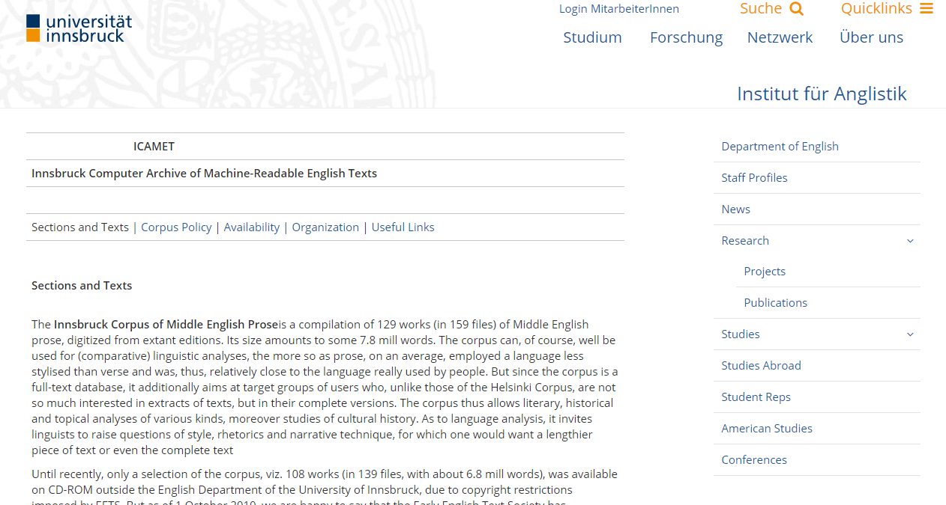
Innsbruck Computer Archive of Machine-Readable English Texts https://www.uibk.ac.at/anglistik/research/projects/icamet/

Slide 17
Size – Innsbruck Corpus of Middle English Prose (about 7.8 mill. words), LC of ICAMET – 182 000 words
sections: Innsbruck Corpus of Middle English Prose, Letter Corpus of ICAMET, HEDGEHOGS (i.e. German and French Schoolbooks of English)
composition: ICMEP - Middle English prose, LC of ICAMET - letters written between 1386 and 1698, HEDGEHOGS - books published between 1650 and 1850
related projects: Spoken English in Early Dialects
access: available in CD-ROM format (10/15 €)

Slide 18
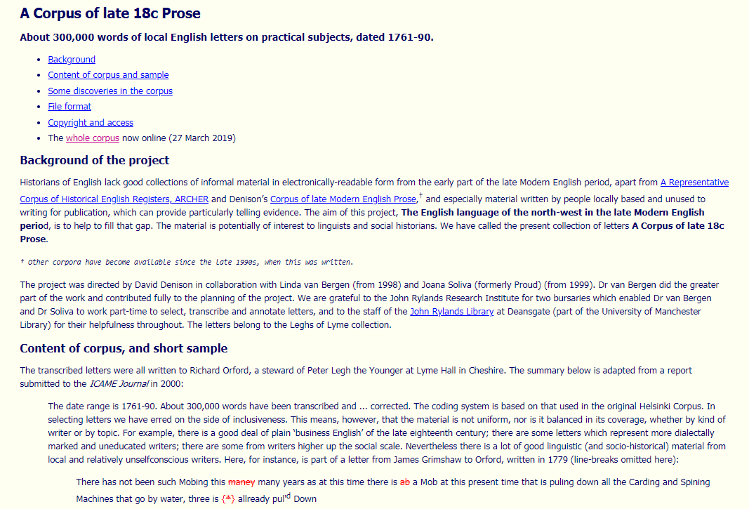
Corpus of late 18c Prose https://personalpages.manchester.ac.uk/staff/david.denison/late18c

Slide 19
Size – about 300 000 words
sections: prose
composition: letters covering the period from 1761 to 1790
related projects: A Corpus of late Modern English Prose, A Representative Corpus of Historical English Registers
access: free online

Slide 20
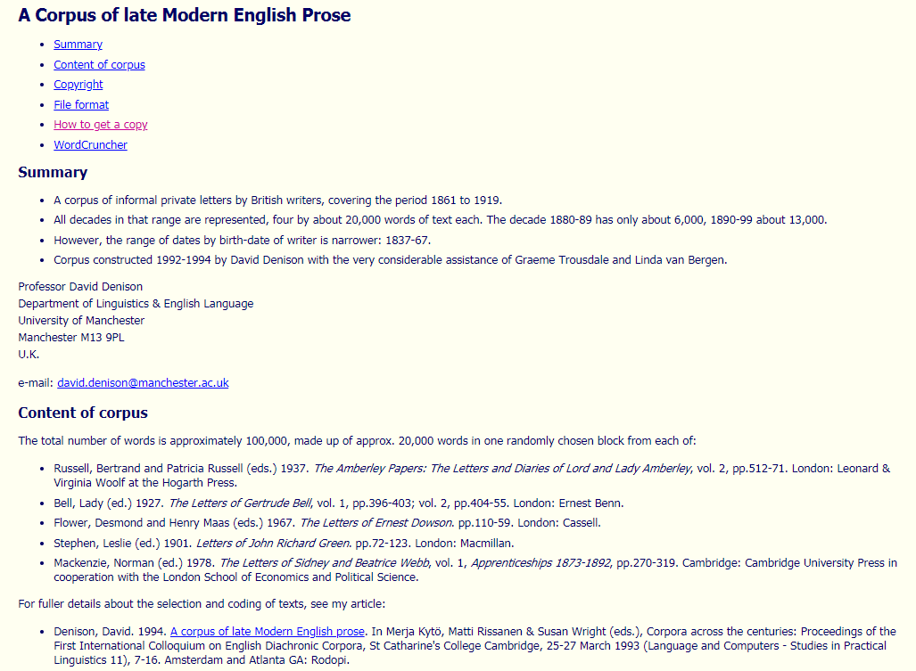
Corpus of late Modern English Prose https://personalpages.manchester.ac.uk/staff/david.denison/LModE_Prose.html

Slide 21
Size – about 100 000 words
sections: all decades in the range are represented, four by about 20,000 words of text each
composition: letters covering the period from 1861 to 1919
related projects: A Corpus of late 18c Prose, A Representative Corpus of Historical English Registers
access: free (registration needed)

Slide 22
Thank you for your attention !

